Slide 1
Hackathon 2024
Team 16
Date: 10/23/2024

Slide 2
Automated Monarch Client Installation

Slide 3
Aspen Technology Disclaimer
Aspen Technology may provide information regarding possible future product developments including new products, product features, product interfaces, integration, design, architecture, etc. that may be represented as “product roadmaps or product visions”. Any such information is for discussion purposes only and does not constitute a commitment by Aspen Technology to do or deliver anything in these product roadmaps or otherwise. Any such commitment must be explicitly set forth in a written contract between the customer and Aspen Technology, executed by an authorized officer of each company.

Slide 4





Participants
Shajahan Basha
Vinoo Titus
Rohini
Daniel Dominguez
Antonio Amador
Hemalatha

Slide 5

Objective
Automate the process of Copying and installing clients to reduce the time spent manually handling this process ,enhancing the productivity of the SQA teams.

Slide 6
Business Use Case
The SQA team receives new client builds daily across various release lines as part of the CI/CD pipeline. These client installations are critical for defect validation and new functionality testing, forming a key part of the team's daily workflow , below process helps to save time spent on repetitive work to focus on other critical areas.
Initiate Process:
The SQA engineer runs the Python automation script, selecting the desired monarch client Suites from the GUI.
Copying the Client:
The script accesses the shared network drive where the monarch client installer is stored. It copies the installer to the target machine. For larger clients, the copying process typically takes 15 to 20 minutes manually, but the script streamlines this, running in the background and completes the process in 2 to 3 minutes.
Installing the Client:
Once the installer is copied to the targeted machine, the script initiates the installation process using appropriate Python Script. The installation process, which usually takes another 15 to 20 minutes, is completed automatically in the background within 5 minutes.
The monarch client successfully installed on the test machine, and the SQA engineer can begin the validation of the new functionalities and defects without delay.

Slide 7
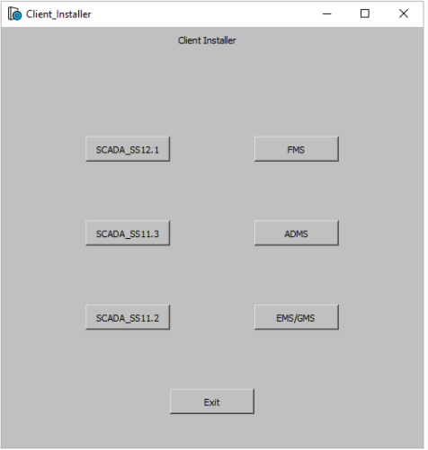
Solution
Create the Python script
Run the script
This will launch the client installer pop up window with the corresponding suite client installation buttons configured in the script.
Click on the required client button to Copy & install the client
This will automatically complete the installation with no human intervention, thereby saving about 15 to 20 minutes of time
This will be centralized solution for installing any monarch installer
across target machines

Slide 8
Benefit
Number of people (approx.) = 55
Time saved = 15 minutes
Average usage days of the installer = 10 days
Soft dollars per hour/per person = 20$
Calculation:
Number of people * 15 minutes * 10 days * 12 months / 60 = 1650 hours
Hours per year * 20 soft dollars = 33000 USD

Slide 9
Future Focus
Integrating with the CI/CD pipeline via Jenkins enables full automation of the client installation process.
This integration ensures continuous installation and streamlining the SQA team's workflow and enhancing overall efficiency.
A pop-up window that appears on completion of the installation process to be automated to close automatically once process is completed

Slide 10
Demo

Slide 11
Thank You

